Slide 1
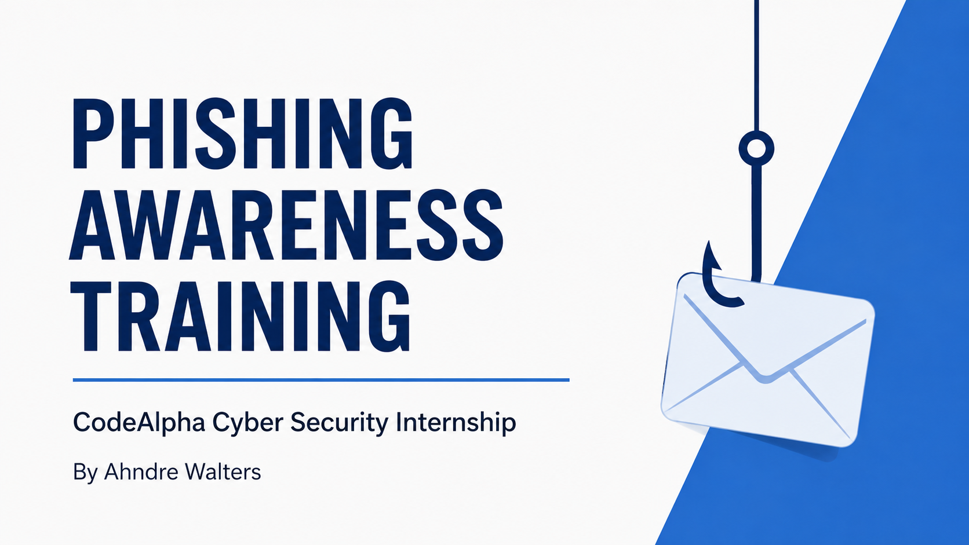
Phishing Awareness Training
CodeAlpha Cyber Security Internship
By Ahndre Walters

Slide 2
What is Phishing?
Phishing is a cyber attack where criminals pretend to be legitimate organizations to steal your personal information.
Attackers send fake emails, messages, or create fake websites to trick you into giving away:
Passwords and usernames
Credit card numbers
Bank account details
Social security numbers
Anyone can be a target. Phishing attacks happen to individuals, employees, and large companies.
How It Works:
Victim receives a fake email or message
Victim clicks a link and enters personal information
Attacker steals the information
Over 90% of cyber attacks start with phishing. One attack can cost individuals and companies thousands or millions of dollars. Understanding phishing is the first step to protecting yourself.

Slide 3
How to Recognize Phishing Emails
CHECK THE SENDER ADDRESS Look carefully at the email address. Scammers use addresses like support@amaz0n.com instead of support@amazon.com. Small differences in spelling are common.
WATCH FOR URGENT LANGUAGE Phishing emails often create panic. They may say your account will be closed, your payment has failed, or you need to verify immediately.
LOOK FOR GENERIC GREETINGS Phishing emails often use generic greetings like “Dear Customer” or “Dear User.”
EXAMINE LINKS BEFORE CLICKING Hover over links to see the real web address. The displayed text may lead to a fake website.
CHECK FOR SPELLING AND GRAMMAR MISTAKES Errors, missing punctuation, and awkward phrasing can be warning signs.
BE WARY OF UNEXPECTED ATTACHMENTS
Do not open attachments from unknown senders. Files like .exe, .zip, or .scr can contain malware. Legitimate companies rarely send attachments without prior notice.

Slide 4
How to Spot Fake Websites
CHECK THE URL CAREFULLY Look for extra characters, misspellings, or unusual domain extensions. Examples: amaz0n.com or facebo0k.com.
THE PADLOCK IS NOT ENOUGH HTTPS encrypts the connection, but fake websites can also use HTTPS. A padlock does not prove a site is legitimate.
CHECK FOR VISUAL ERRORS Incorrect logos, unusual colors, poor layouts, or broken images may indicate a fake site.
TYPE THE ADDRESS YOURSELF Avoid links from suspicious emails. Enter the company's official web address directly into your browser.
LOOK FOR POOR WEBSITE DESIGN
Fake sites often have low-quality images, mismatched fonts, or broken navigation links. Professional companies invest in well-designed websites.
VERIFY THE DOMAIN AGE
Fake websites are often newly created. You can check domain age using online tools. A very new domain with a popular brand name is suspicious.
CONTACT THE COMPANY DIRECTLY Use an official phone number or website, not contact information from a suspicious message.

Slide 5
Social Engineering Tactics Used by Attackers
AUTHORITY - Attackers pretend to be a CEO, police officer, government official, or IT support.
URGENCY - They create a false emergency and pressure you to act immediately.
FEAR - They use threats such as account compromise, investigations, or identity theft.
FAMILIARITY - They use information from social media to appear trustworthy or familiar.
CURIOSITY - Messages like "Did you see this video of you?" encourage impulsive clicks.
RECIPROCITY - Attackers offer help or a small favor to create a sense of obligation.
SCARCITY - They claim limited time offers or exclusive deals to pressure you into acting quickly.
TRUST - Attackers build a relationship over time before asking for sensitive information.
CONFUSION - They use complex language or contradictory information to make you doubt your judgment.
FLATTERY - They praise you or appeal to your ego to lower your defenses.
SOCIAL PROOF - They claim others have already complied, such as "Everyone in your department has already completed this.“
OBLIGATION - They remind you of a past favor or interaction to make you feel you owe them.

Slide 6
Real-World Examples
EXAMPLE 1: PAYPAL PHISHING EMAIL From: service@paypa1.com | Subject: Your account has been limited “Dear Customer, your account has been temporarily limited. Click the link to verify your information.” Red flags: paypa1.com is fake • generic greeting • urgent threat • suspicious link
EXAMPLE 2: CEO FRAUD EMAIL “I need you to purchase $500 in gift cards right now for a client meeting. Please send me the card codes.” Red flags: unusual gift-card request • urgency • request to send codes by email
EXAMPLE 3: FAKE BANK WEBSITE www.chase-secure-login.com The URL is wrong even if the page looks like a bank website. The real Chase website is www.chase.com. Red flags: wrong URL • asks for login details • possible visual errors
EXAMPLE 4: SMISHING TEXT MESSAGE
From: 1-800-555-0123 | Message: "FedEx: Your package #789012345 is delayed. To reschedule delivery, click: http://fedex-delivery-reschedule.top"
Red flags: suspicious URL • FedEx does not send texts like this • unsolicited message • link uses .top domain instead of .com

Slide 7
Interactive Quiz
Bank email says your account will close unless you click a link. Sender: security@bank-security-verify.com. PHISHING? YES | suspicious sender + urgency.
Text says you won a free iPhone and must click a link. PHISHING? YES | this is smishing.
Boss urgently asks you to buy gift cards and send codes. PHISHING? POSSIBLY | verify by calling your boss using the official company number.
PayPal email displays https://www.paypal.com/secure. PHISHING? CHECK THE ACTUAL URL | displayed text can hide a fake destination.
Bank email contains poor grammar and spelling errors. PHISHING? YES | this is a warning sign.
Email from HR with attachment called "Bonuses_2026.pdf" and no other details. PHISHING? POSSIBLY | verify with HR before opening attachments from unexpected emails.
You receive a LinkedIn message from a recruiter asking for your personal email and phone number immediately. PHISHING? POSSIBLY | legitimate recruiters do not rush you for personal information.
Email says "Your Netflix subscription has expired. Update your payment method to continue watching." The link goes to netflix-update-login.com. PHISHING? YES | suspicious URL and creates urgency.

Slide 8
Best Practices to Avoid Phishing
THINK BEFORE YOU CLICK - Pause and inspect links before clicking.
VERIFY THE SENDER - Check email addresses for misspellings and extra characters.
ENABLE TWO-FACTOR AUTHENTICATION - Adds an extra security layer if your password is stolen.
KEEP SOFTWARE UPDATED - Install updates and security patches for your operating system, browser, and security software.
USE STRONG AND UNIQUE PASSWORDS - Use different passwords for every account and consider a password manager.
REPORT SUSPICIOUS EMAILS - Tell your IT department or security team.
NEVER SHARE PERSONAL INFORMATION VIA EMAIL - Be cautious of requests for passwords, card numbers, or sensitive information.
WHEN IN DOUBT, VERIFY - Contact the organization through official channels.
BE CAUTIOUS WITH ATTACHMENTS - Do not open attachments from unknown or unexpected senders. Even known senders can have compromised accounts.
TRUST YOUR INSTINCTS - If something feels wrong or too urgent, it probably is. Take a moment to step back and assess the situation before taking any action.

